Slide 1
Pizza Sales Analysis

Slide 2
INTRODUCTON
I’m Anshdeep Singh Rajput and this presentation
delves into a comprehensive analysis of pizza sales data utilizing SQL queries.
We will explore sales trends, identifying peak periods and popular menu items.
By leveraging SQL’s capabilities, we will uncover valuable
insights into customer behavior and ordering patterns.
This data-driven approach aims to provide actionable
recommendations to enhance sales strategies and
customer satisfaction.

Slide 3
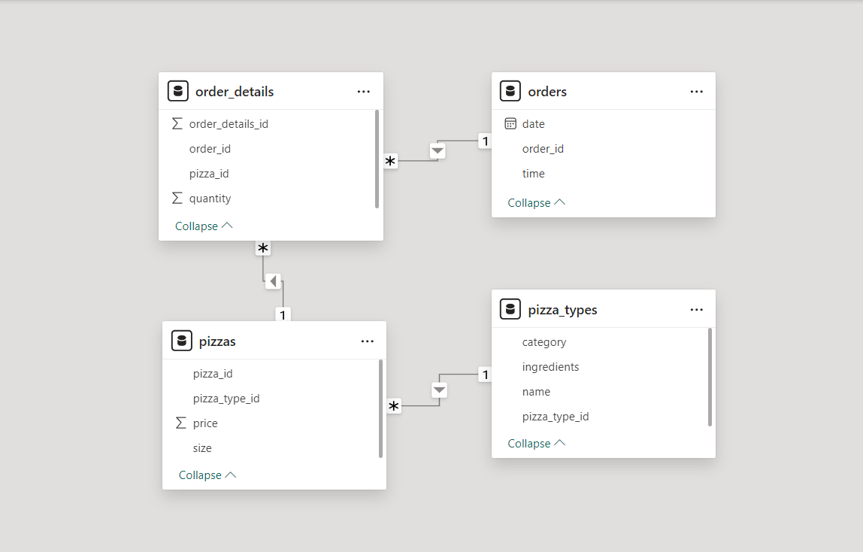
DATASET SCHEMA

Slide 4

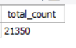
Retrieve the total number of orders placed.

Slide 5
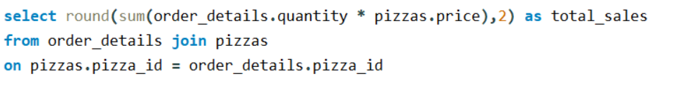
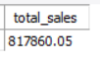
Calculate the total revenue generated from pizza sales.

Slide 6
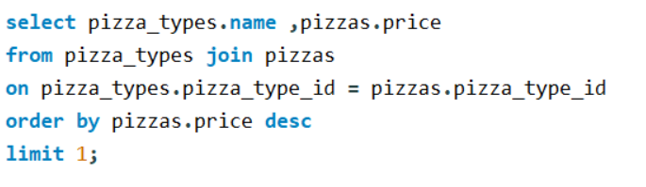
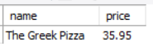
Identify the highest-priced pizza.

Slide 7
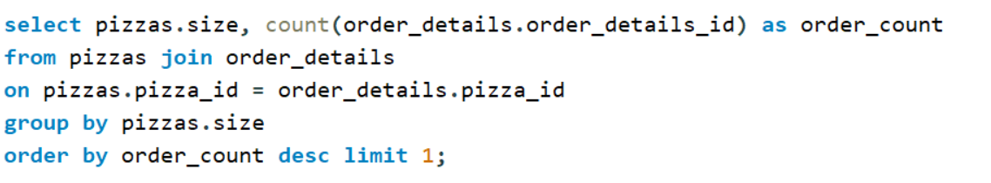
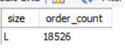
Identify the most common pizza size ordered.

Slide 8
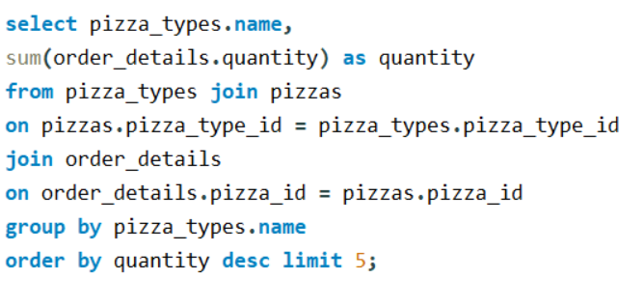
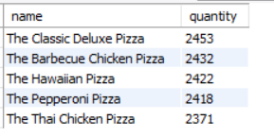
List the top 5 most ordered pizza types along with their quantities.

Slide 9
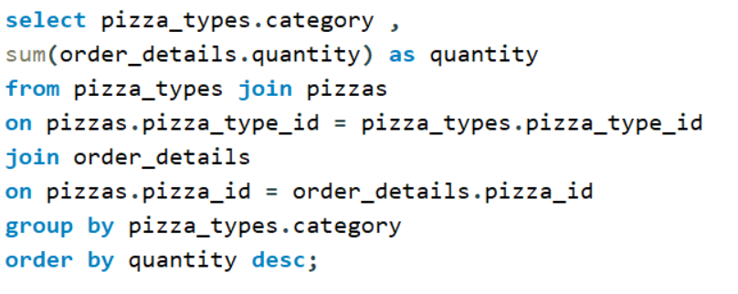
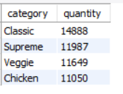
Join the necessary tables to find the total quantity of each pizza category ordered.

Slide 10
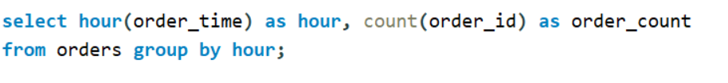
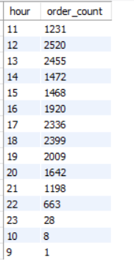
Determine the distribution of orders by hour of the day.

Slide 11
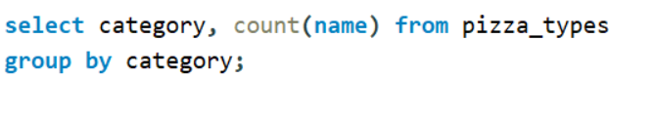
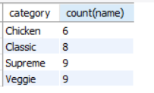
Join relevant tables to find the category-wise distribution of pizzas.

Slide 12
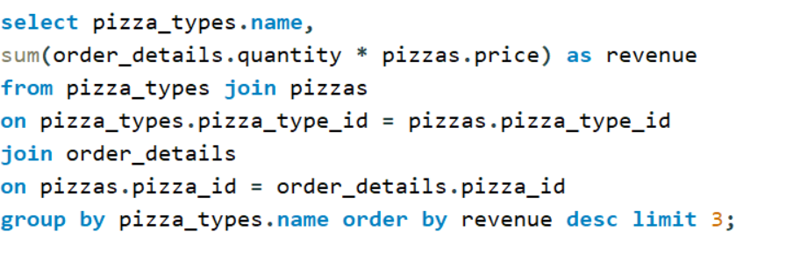
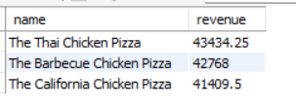
Determine the top 3 most ordered pizza types based on revenue.

Slide 13
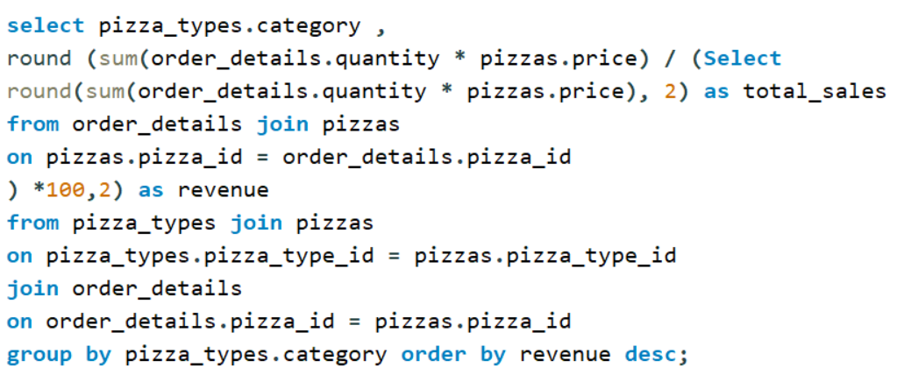
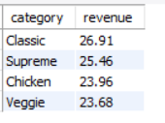
Calculate the percentage contribution of each pizza type to total revenue.

Slide 14
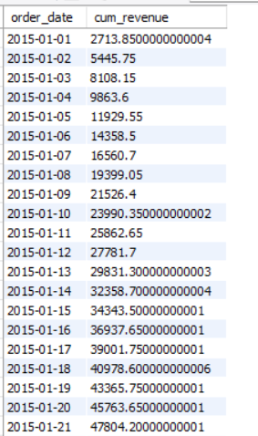
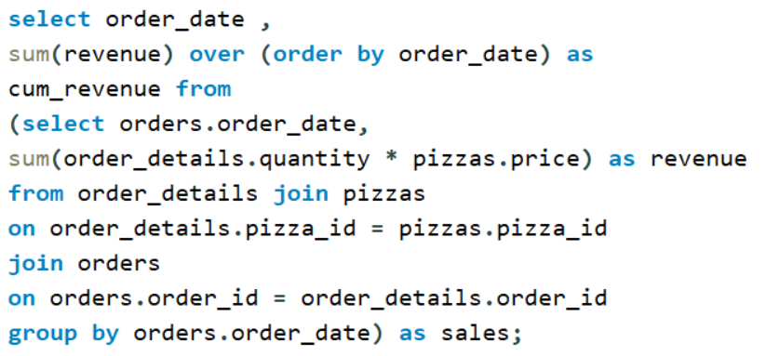
Analyze the cumulative revenue generated over time.

Slide 15
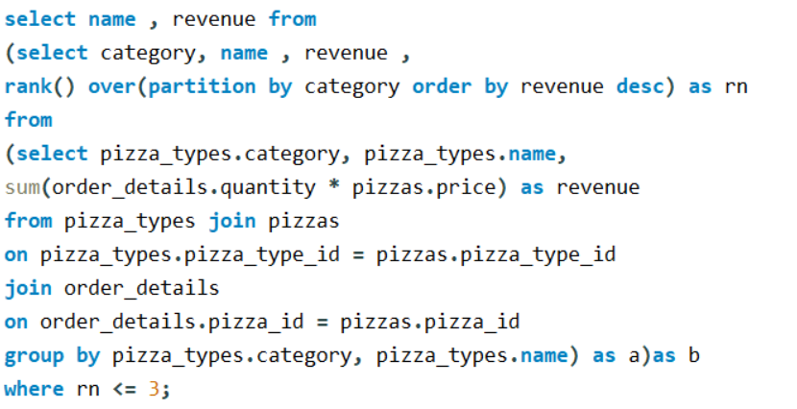
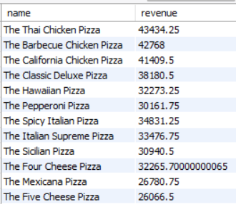
Determine the top 3 most ordered pizza types based on revenue for each pizza category.

Slide 16
THANK YOU

